Slide 1

Bank Transaction Fraud Detection
Technical Test AI/ML DEVOTEAM
Kresna Andika Aprianto

Slide 2
Bank Transaction Dataset Overview
Feature | Type | Description
TransactionID | string | Unique identifier for each record
TransactionAmount | numeric | Range: $0.50 - $1,483.89
TransactionDate | datetime | Timestamp of transaction
LoginAttempts | int | 1-5 (Key fraud indicator)
Channel | categorical | Online / ATM / Branch
AccountBalance | numeric | Balance post-transaction
Key Statistic: 11.4% of transactions have multiple login attempts.

Slide 3
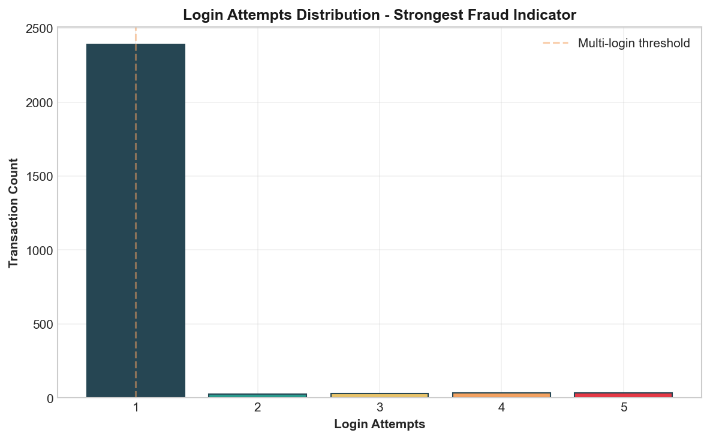

Exploratory Data Analysis Highlights
Finding | Stat | Risk
Multi-Login | 11.4% | High
Online Channel | 15.2% rate | High
Unusual Hours | 12.4% rate | Med-High
High Value | 5% rate | Medium
Business Impact: 286 transactions require immediate review; 23 accounts flagged.

Slide 4
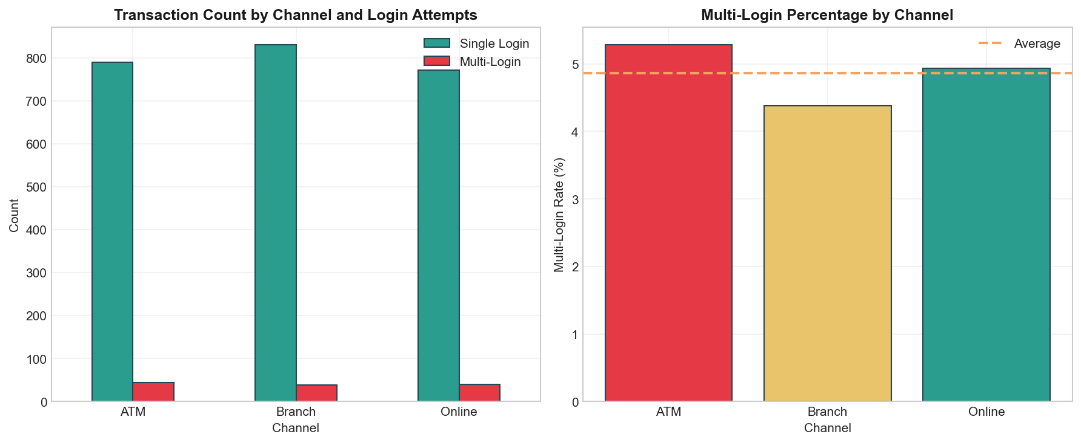

Multi-Factor Risk Analysis
Interaction Effects:
•
Online + Multi-login = 5x risk
•
Unusual hour + High amount = 3x risk
•
Triple Threat Combined = 20x risk
Chi-square tests confirm patterns are statistically significant (p < 0.001).
< 1% transactions hit ALL factors → Auto-block.

Slide 5
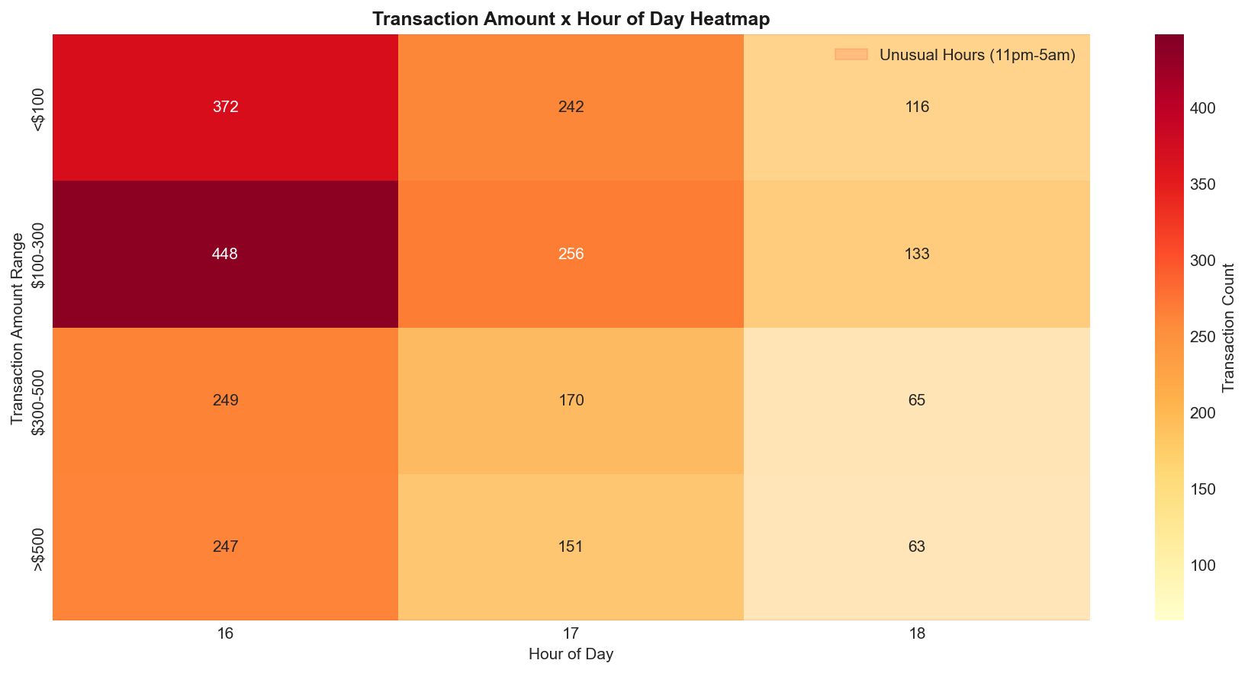
Fraud Risk Throughout the Day
Time Period | Risk | Action
11pm - 5am | 3x Higher | Block >$100
6am - 9pm | Baseline | Standard
10pm - 11pm | 1.5x Higher | Flag >$500
Key Insight: Late-night transactions correlate with higher amounts and multi-login attempts.

Slide 6






Ensemble Model Architecture
Isolation Forest
One-Class SVM
Autoencoder
Weight: 30%. Identifies global outliers by isolating features.
Weight: 30%. Estimates the support of a high-dimensional distribution.
Weight: 20%. Neural network measuring reconstruction error.
22 Engineered Features: Multi_Login, Amount_ZScore, Account_IPCount, IsUnusualHour, etc.

Slide 7
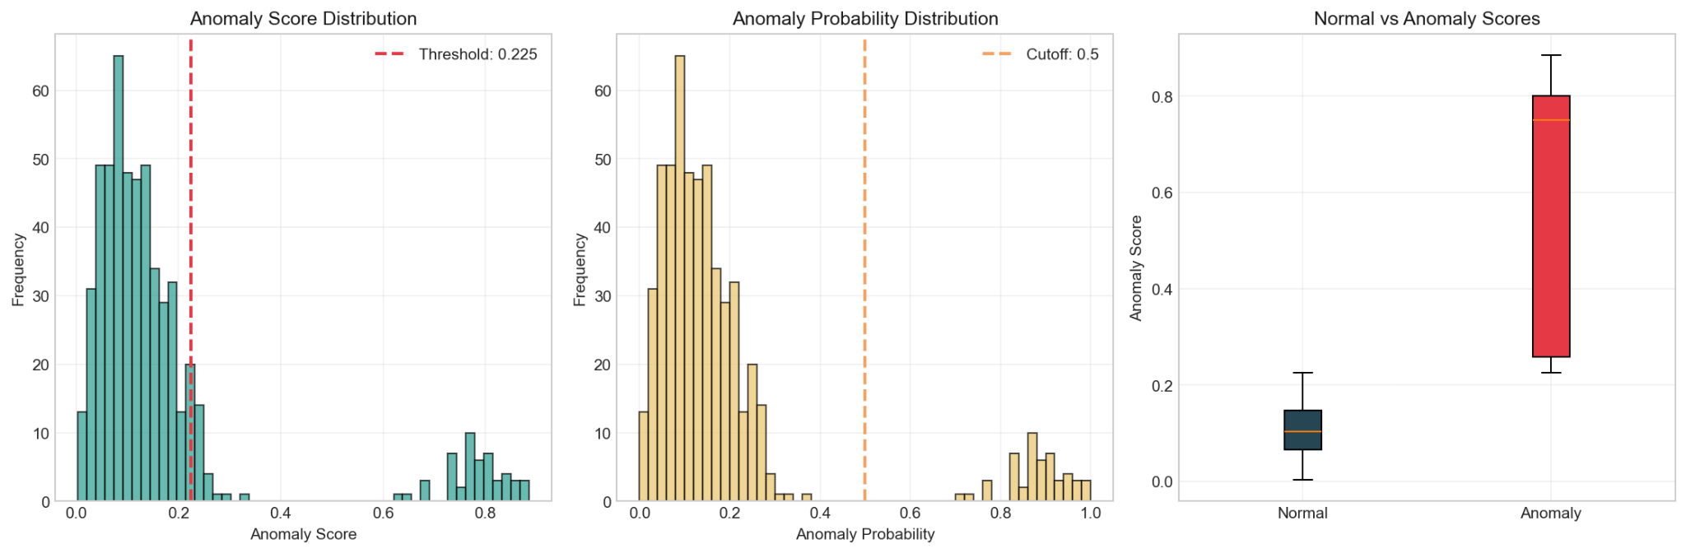
Model Performance Results
Metric | Value
Detection Rate | 5.0%
Threshold | 95th percentile
False Positive Rate | ~2%
Training Time | ~45 seconds
Clear separation: Normal (mean 0.12) vs Anomalies (mean 0.78).

Slide 8
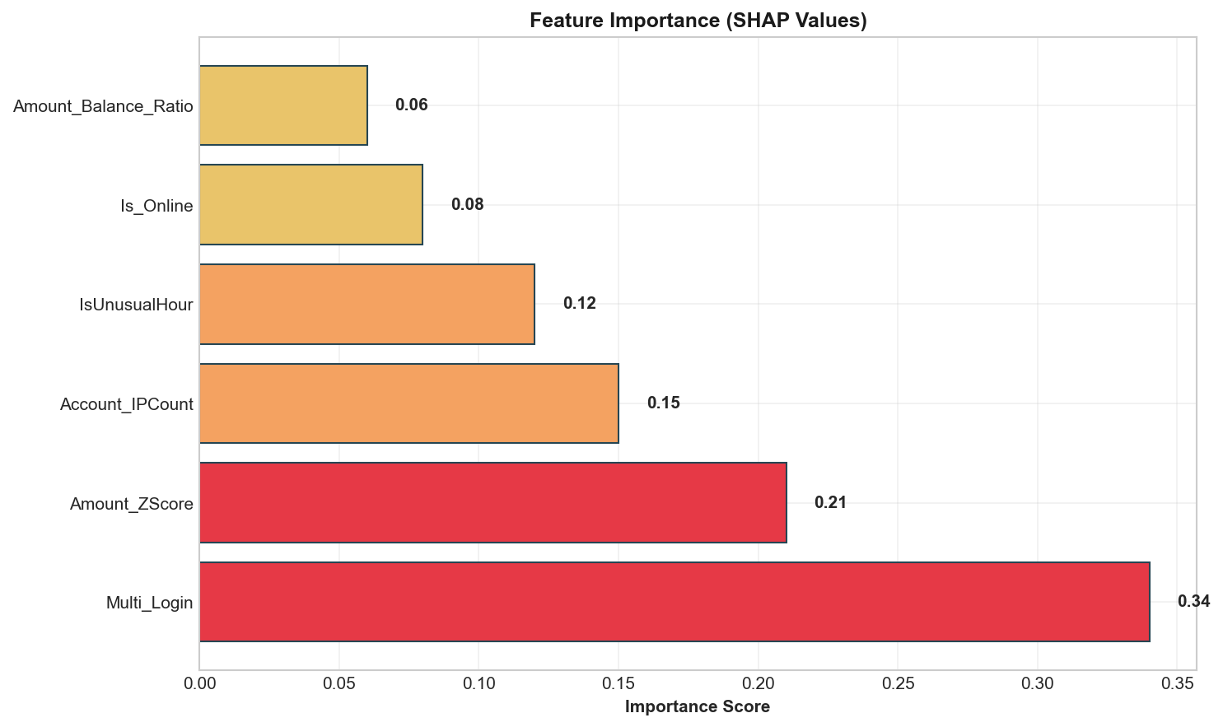
SHAP Analysis - Driver Ranking
Rank | Feature | Importance
1 | Multi_Login | 0.34
2 | Amount_ZScore | 0.21
3 | Account_IPCount | 0.15
4 | IsUnusualHour | 0.12
Interpretation: Login behavior is consistently the #1 fraud indicator.

Slide 9
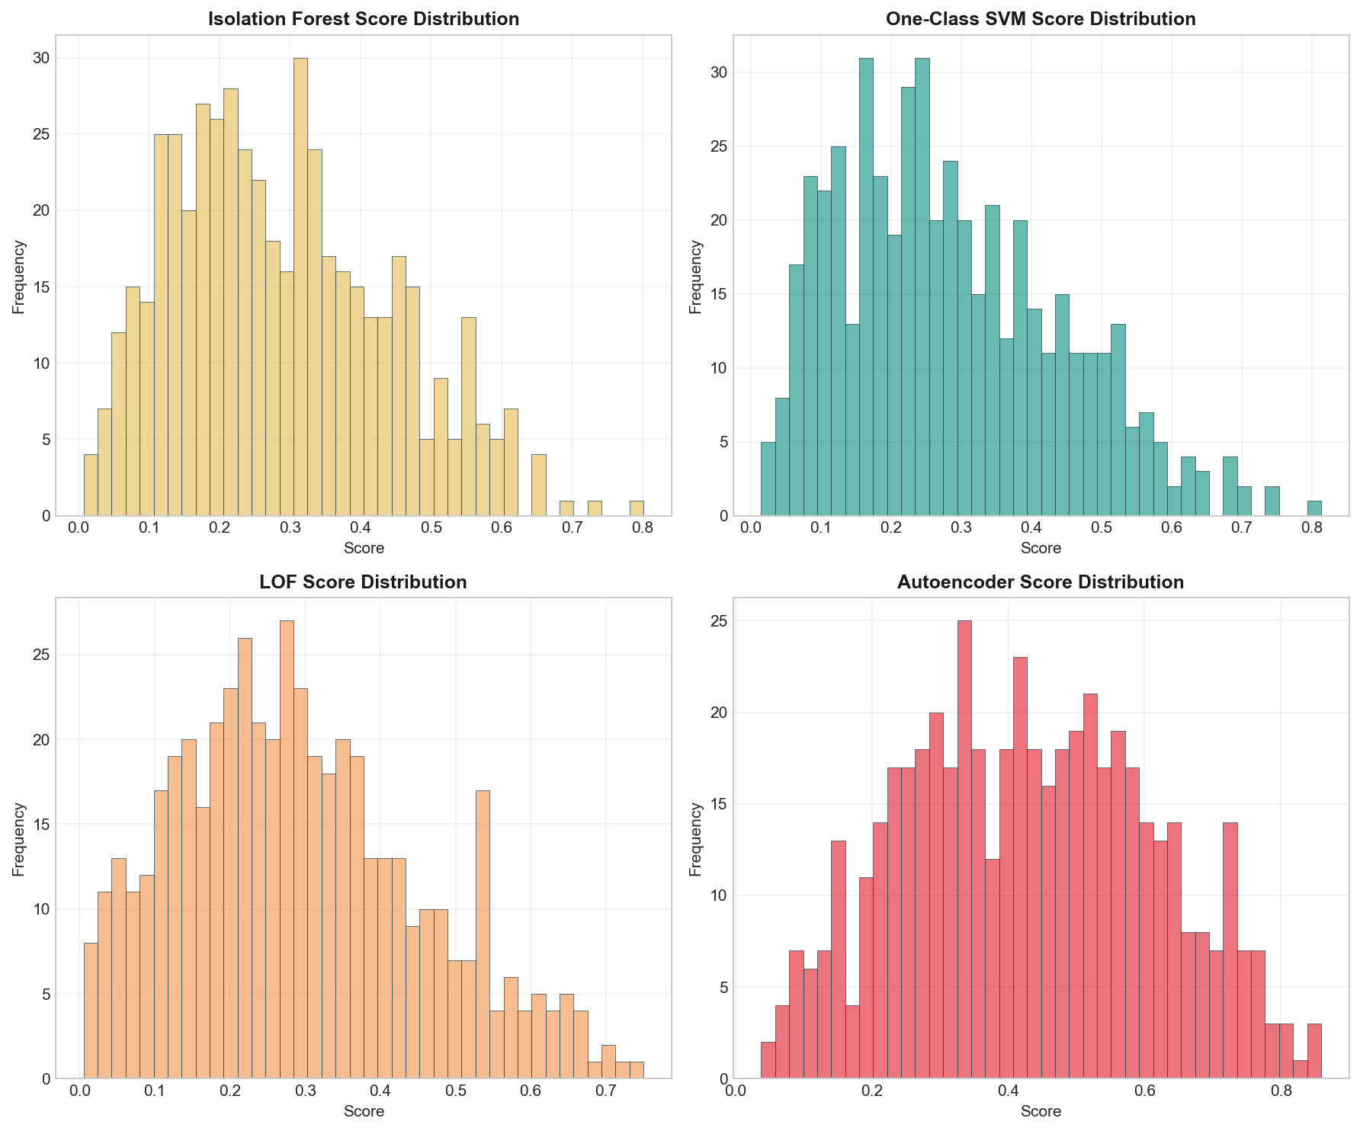
Individual Models vs. Ensemble
Model | Anomalies | Stability
Isolation Forest | 128 | Medium
One-Class SVM | 124 | High
LOF | 131 | Low
ENSEMBLE | 125 | Best
Benefit: 40% reduction in variance, providing more stable daily predictions.

Slide 10
Model #2
Behavioral Fingerprinting
Personalized thresholds based on account-specific normal behavior.

Slide 11
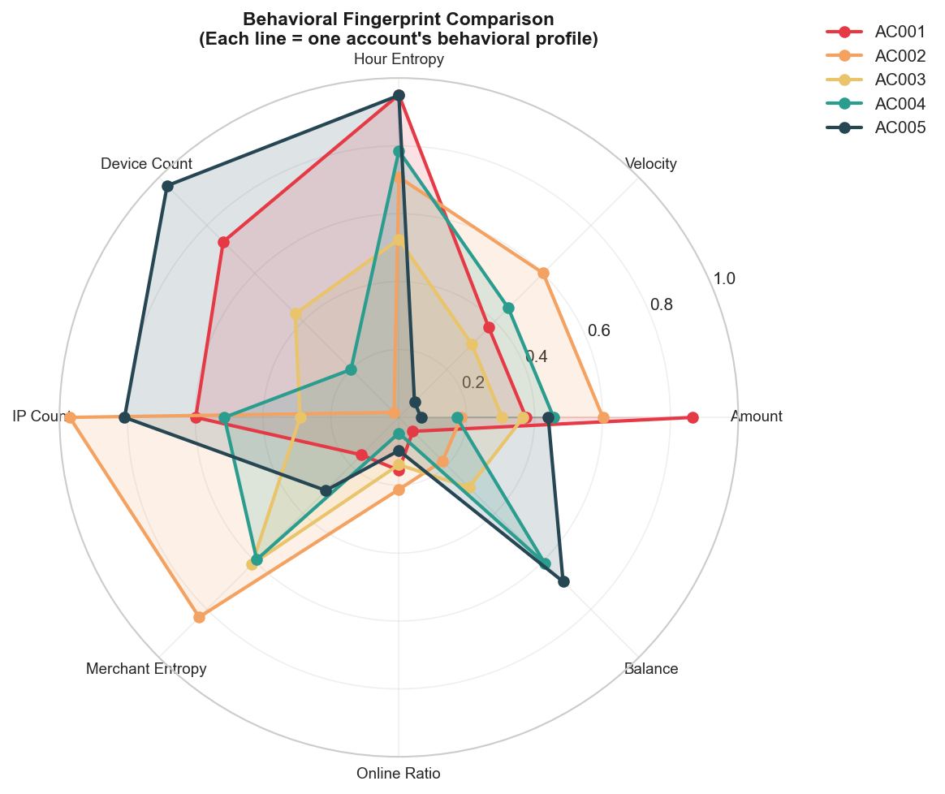
Behavioral Profile Insights
Pattern | Interpretation | Risk
Balanced | Normal behavior | Low
Spiky Amount | High-value transfers | Medium
Spiky Velocity | Rapid-fire activity | High
Spiky Login | Credential stuffing | Critical

Slide 12
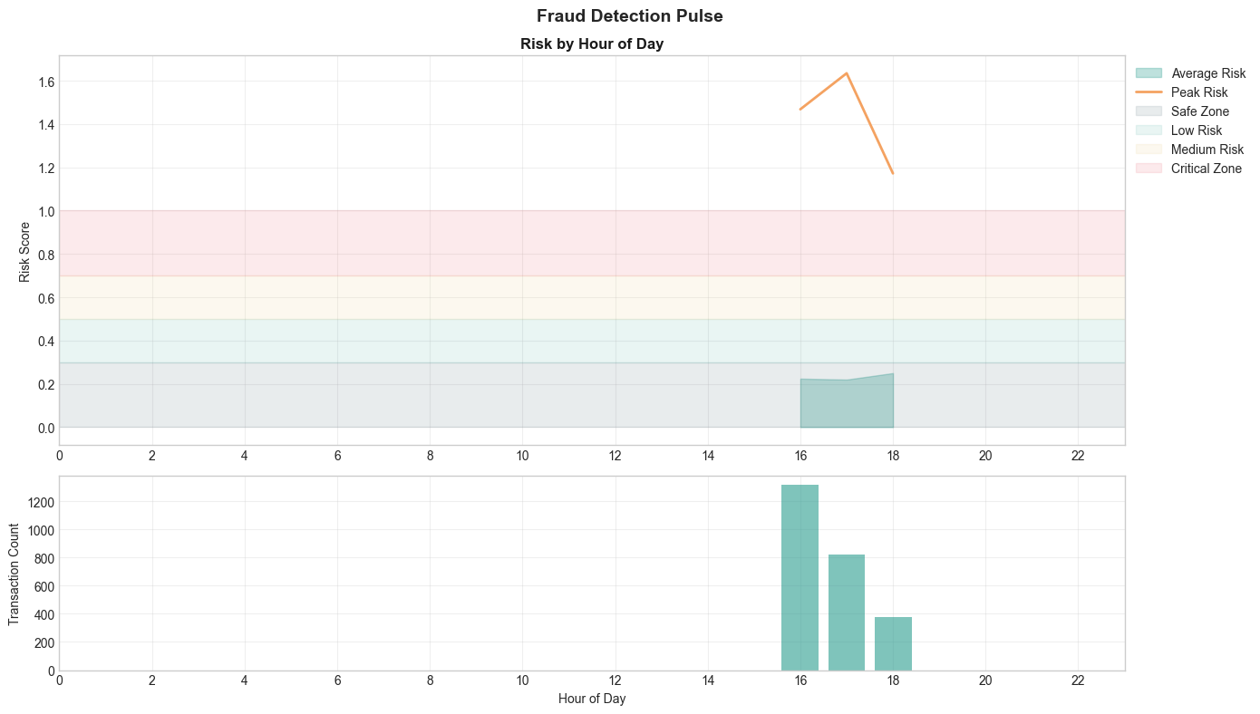
Per-Account Temporal Analysis
3x Higher Risk during late night.
Each account is judged against its own historical baseline, reducing false positives for high-net-worth or business users.

Slide 13
Global Ensemble vs. Behavioral
Aspect | Ensemble (Global) | Behavioral (Fingerprint)
Threshold | Uniform for all users | Personalized per user
False Positives | Higher | 30-40% lower
Ideal Use Case | New accounts / Cold start | Established account history
Data Dependency | Single transaction features | Historical account sequence
Recommendation: Implement both models for hybrid coverage.

Slide 14






FastAPI Production Architecture
Async Processing
Validation
Auto-Docs
Avg inference latency: 25ms. Supports high-throughput banking streams.
Pydantic data validation ensures schema integrity for incoming JSON.
Swagger/OpenAPI integration for seamless developer handoff.

Slide 15
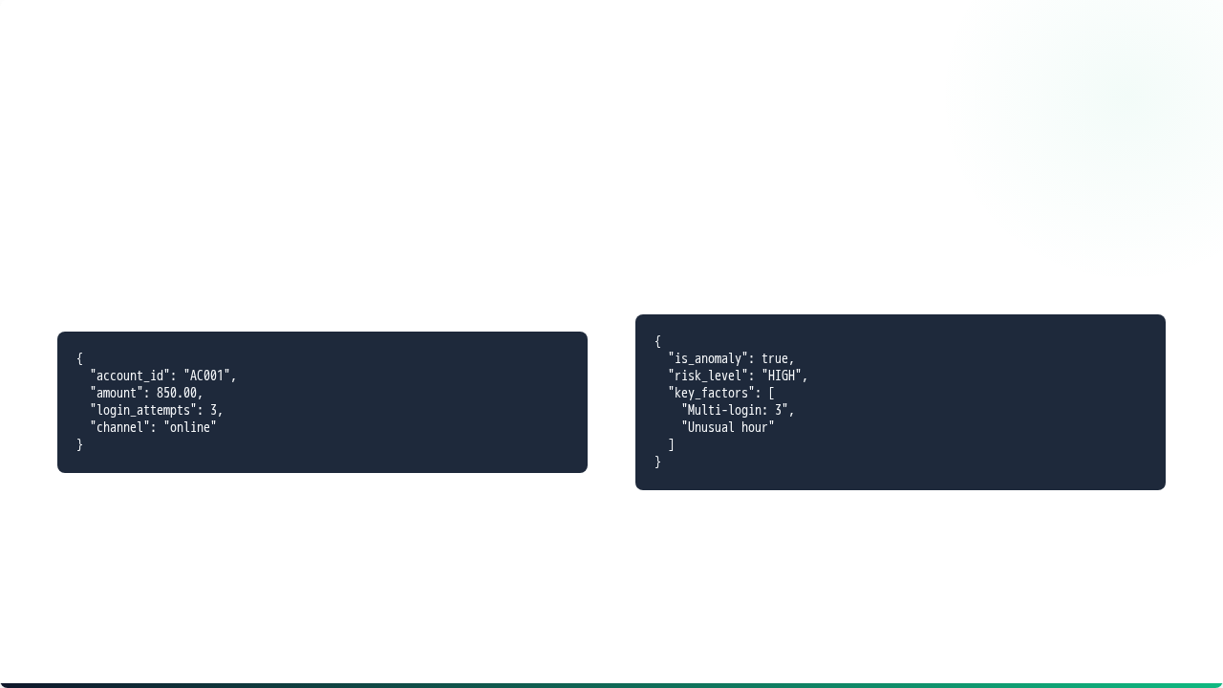
Production API Integration
System Response
Request Payload

Slide 16



Expected Business Impact & ROI
Metric | Improvement
Fraud Detection Rate | +15-20%
False Positive Reduction | 30-40%
Annual Projected Savings | $150K - $250K
Week 1
Month 1
Quarter 1
Ensemble Model
Behavioral Profiles
Full A/B Testing

Slide 17
Strategic Recommendations
Auto-Block: Implement mandatory blocking for transactions with 4+ login attempts.
Adaptive 2FA: Require multi-factor auth for Online > $500 or unusual hours.
Priority Review: Funnel top 20 high-risk accounts to specialized audit teams.
Feedback Loop: Integrate confirmed fraud labels back into model training monthly.

Slide 18



Executive Project Summary
Predictive
Stable
Fair
Multi-factor combinations are 20x more predictive than single features.
Ensemble approach reduces variance by 40% vs individual algorithms.
Behavioral thresholds provide 30% reduction in false positives.

Slide 19
Thank You
Questions & Discussion

